Slide 1
Moist Baroclinic Waves Test
Control run (Kessler large-scale precipitation only)
Sensitivity tests
Simple physics: boundary layer & surface fluxes
Horizontal diffusion
name | Kessler LS Pr. | BL & surf. flux | HD order
Test161_noSP | ✔ |  | 2
Test161 | ✔ | ✔ | 2
Test161_noSP_hd6 | ✔ |  | 6
Test161_ops02 | ✔ | ✔ | 6

Slide 2
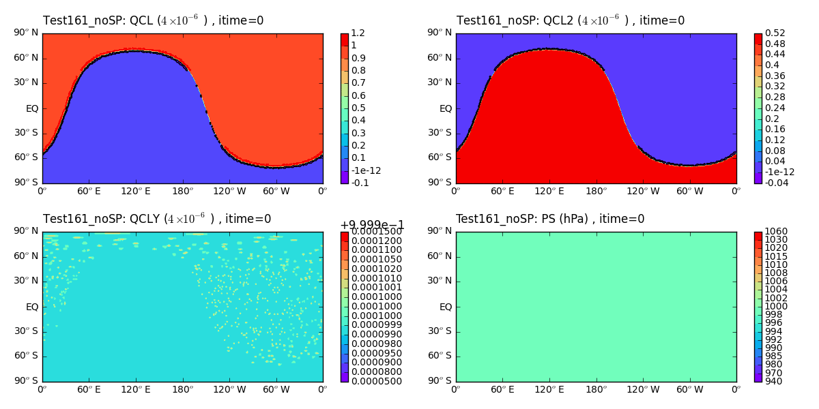
Control run: Kessler large-scale precipitation only, HD order=2
Black contours: -1e-12

Slide 3
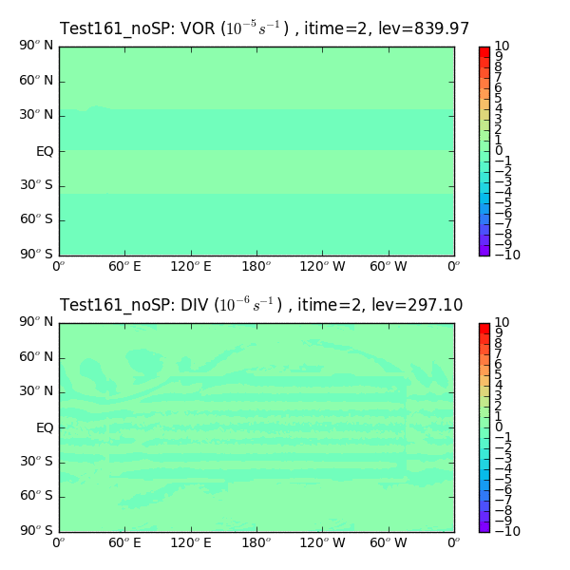
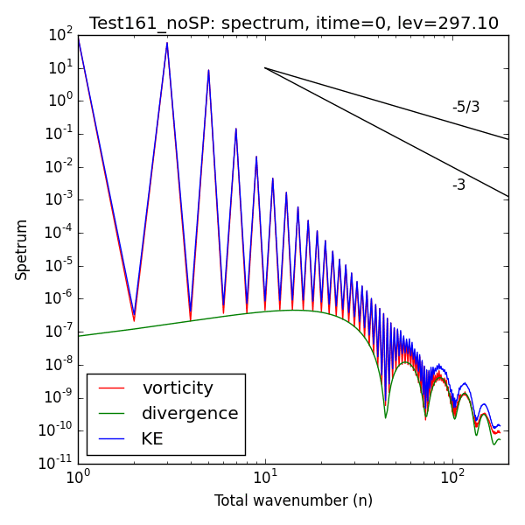
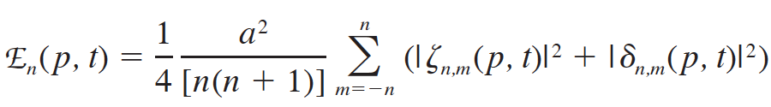
Control run: Kessler large-scale precipitation only, HD order=2

Slide 4
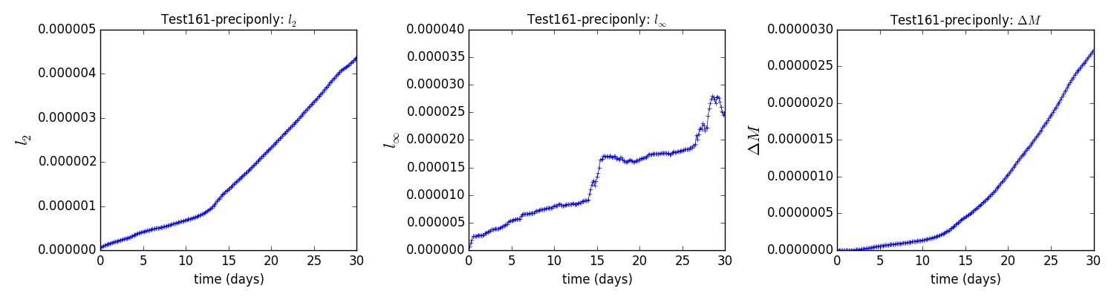
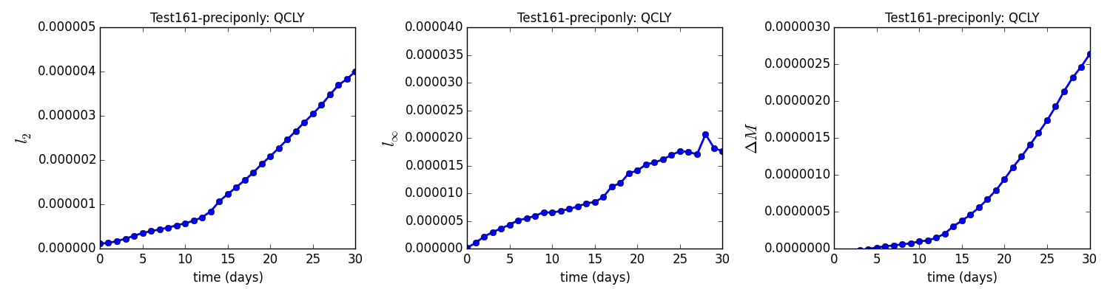
Control run: Kessler large-scale precipitation only, HD order=2
Model output error norms
4.3e-6
2.8e-5
2.7e-6
Our calculation (based on interpolated lat-lon grid)
4.0e-6
2.1e-5
2.6e-6

Slide 5
Sensitivity tests

Slide 6
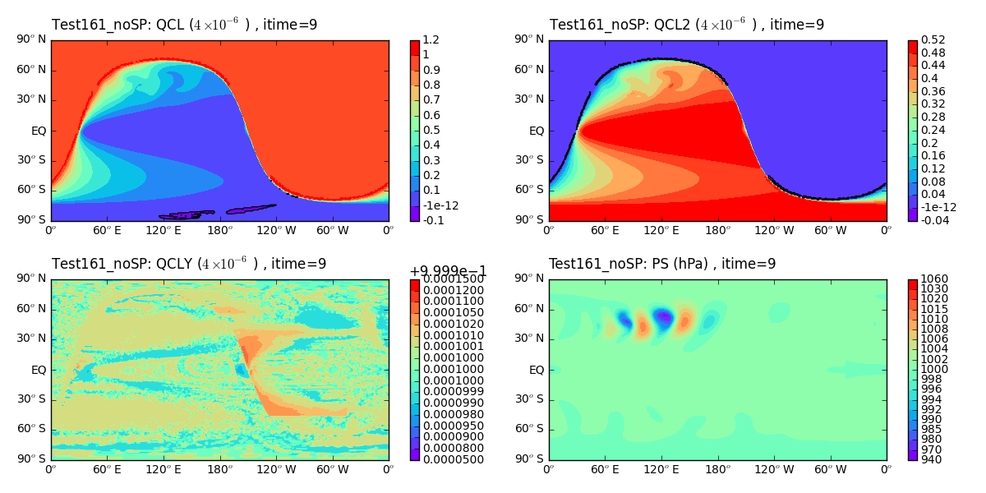
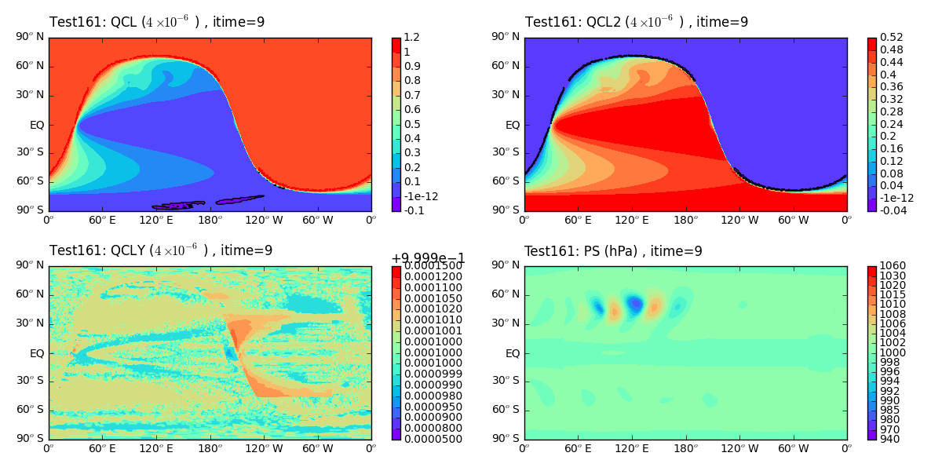
Sensitivity on simple physics: QCL & QCL2 at day 9
Kessler precipitation only
Kessler precipitation, Boundary layer, and surface fluxes

Slide 7
Sensitivity on simple physics: QCLy & Ps at day 9
Kessler precipitation only
Kessler precipitation, Boundary layer, and surface fluxes

Slide 8
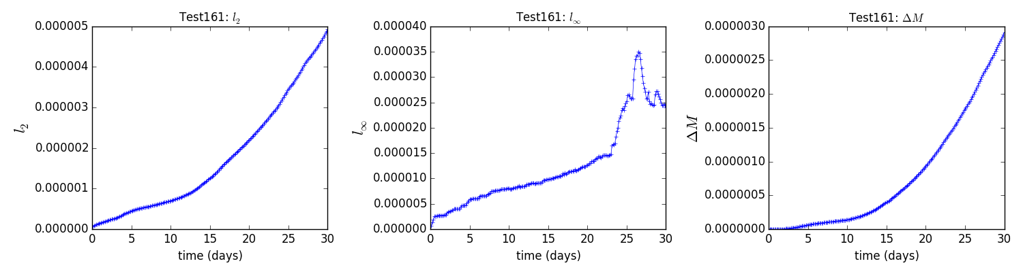
Sensitivity on simple physics: QCLy error norms
Kessler precipitation only
4.3e-6
2.8e-5
2.7e-6
Kessler precipitation, Boundary layer, and surface fluxes
4.9e-6
3.5e-5
2.9e-6

Slide 9
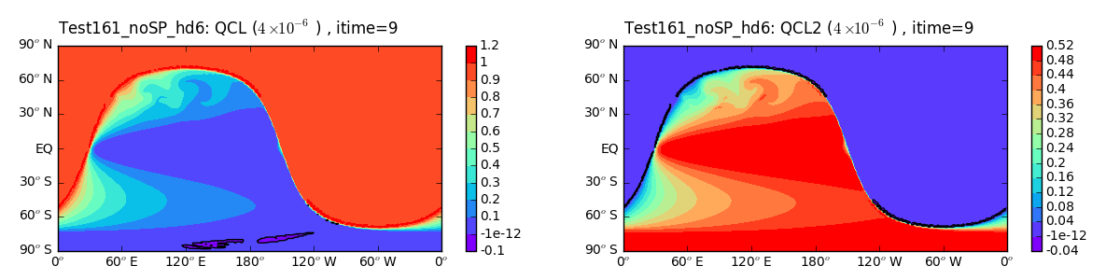
Sensitivity on horizontal diffusion: QCL & QCL2 at day 9
Control run (HD order = 2)
Sensitivity run (HD order = 6; but 2 for tracer)

Slide 10
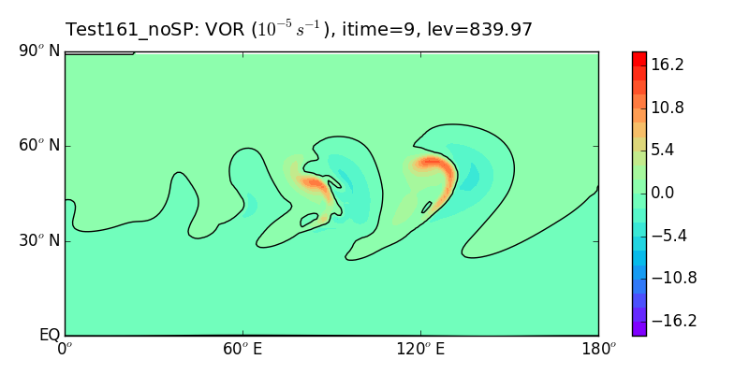
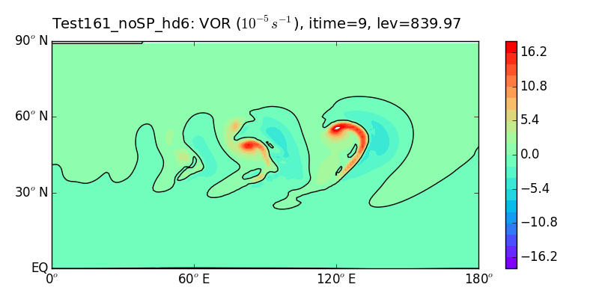
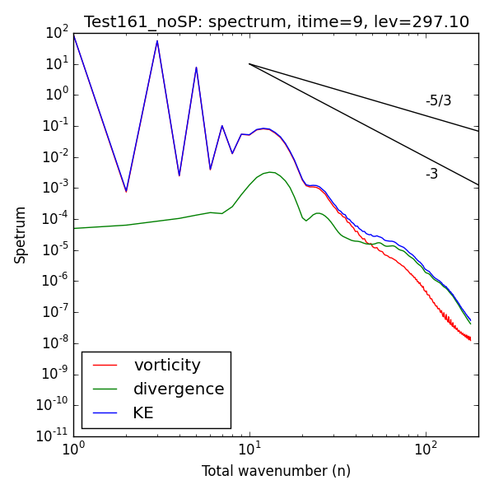
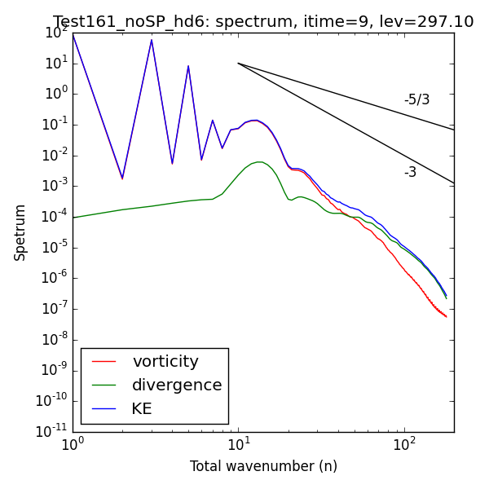
Sensitivity on horizontal diffusion: vorticity and spectra at day 9 [precip. only]
Sensitivity run (HD order = 6; but 2 for tracer)
Control run (HD order = 2)

Slide 11
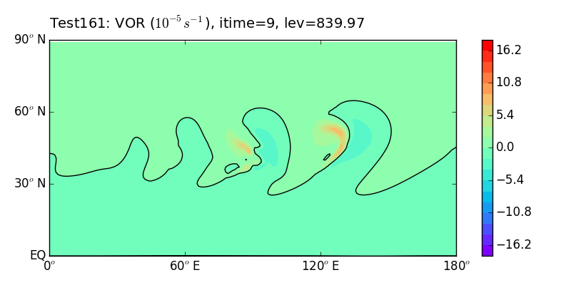
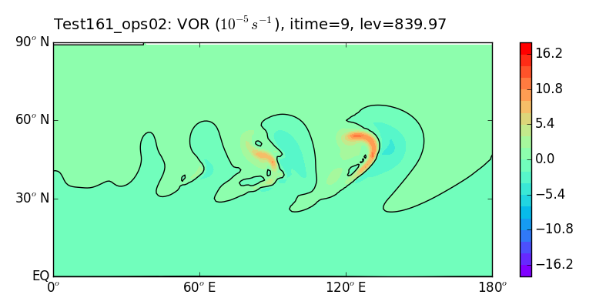
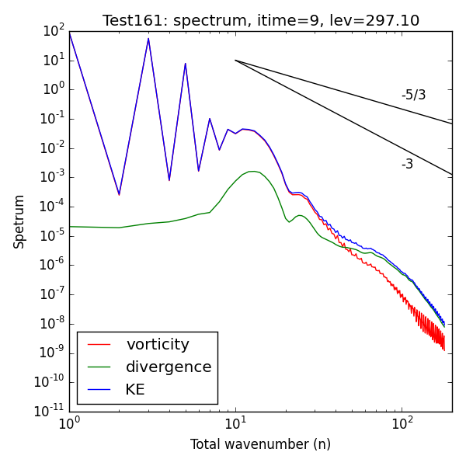
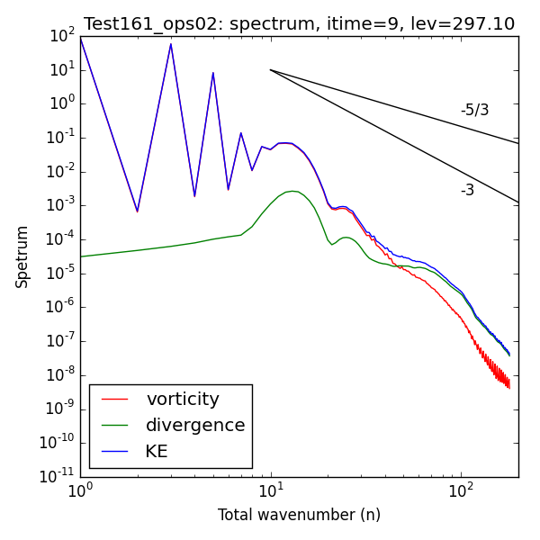
Sensitivity on horizontal diffusion: vorticity and spectra at day 9 [with PBL, surf. fluxes]
Sensitivity run (HD order = 6; but 2 for tracer)
Control run (HD order = 2)

Slide 12
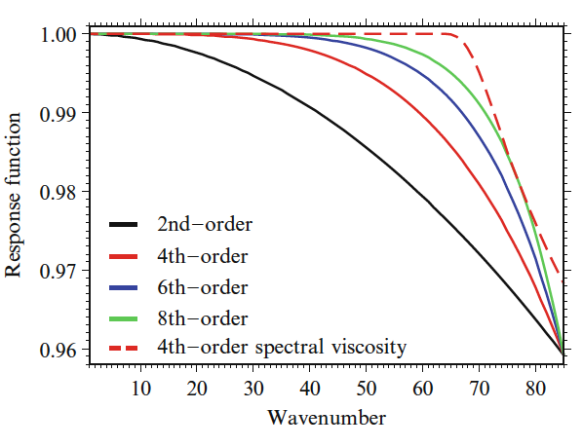
P.H. Lauritzen et al. (eds.), Numerical Techniques for Global Atmospheric Models
Chapter 13. C. Jablonowski and D.L. Williamson

